Slide 1

Enhancing Heart Stroke Disease Prediction accuracy using Machine Learning Models
Under the Guidance of :
B.Madhan Mohan Sir,
HOD ECE,
RGUKT RK VALLEY,KADAPA
Team Members:
T.SAI YOGESH(R170268)
A.SUBBARAYADU(R170979)
O.VENKATA KRISHNAIAH(R170452)
Department of Electronics and Communication Engineering,
RGUKT RK VALLEY, KADAPA (DIST) , AP,
APRIL 2023.

Slide 2
Contents
Introduction
Abstract
Existing System
Proposed System
Theory
Data Description
Flow Chart
Software & Tools Used
Exploratory Data Analysis
Model Building & Evaluation
Model Comparision
Future Enhancement
Conclusion

Slide 3
Introduction
Heart Attack is a term that assigns a large number of medical conditions related to heart
Now a days, heart disease are increasing day by day at an exponential rate due to Inactive Lifestyle , Unhealthy Food Habit
Physical activities have reduced drastically due to increase in busy work life.
The annual mortality rate per 100,000 people from cardiovascular diseases in India has increased by 128.9% since 1990, an average of 5.6% a year.
Now the heart strokes are a matter of serious concern especially in Young people due to several health factors that need to be addressed.

Slide 4
Abstract
Cardiovascular disease refers to any critical condition that impacts the heart. Because heart strokes can be life-threatening, researchers are focusing on designing smart systems to accurately diagnose them based on electronic health data, with the aid of machine learning algorithms.
This work presents several machine learning approaches for predicting heart diseases, using data of major health factors from patients. The Machine learning
Models includes SVM,Naive Bayes, Logistic Regression, Random Forest and XG Boost algorithms are used for Prediction and the Random Forest model is the best performing model with 90.16% accuracy.

Slide 5
Existing System
The WHO estimates that around 12 million deaths occur world wide due to cardiovascular diseases includes Heart Strokes.
About 25% of deaths occur in the age group of 25 - 69 years because of heart diseases and about 32.8% in Urban areas while 22.9% in rural areas.
In the existing system,the diagnosis of diseases is a significant and tedious task in medicine
Treatment of the said disease is quite high and not affordable by most of the patients particulary in India.

Slide 6
Proposed System
“Heart Stroke Prediction” system based on predictive modeling predicts the disease of the user on the basis of the attributes(features) that user provides as an input to the system and gives the probability of the disease as an output.
Disease Prediction is done by implementing 7 techniques:
Logistic Regression Decision Tree
Naïve Bayes Random Forest
K – Nearest Neighbours XG Boost
Support Vector Machines
These techniques calculate the probability of the disease. Therefore, maximum prediction accuracy probability is achieved by Random Forest Model about 90.16% is obtained.

Slide 7
Theory
Machine Learning Algorithms:
Machine learning algorithms are used to automatically learn patterns and relationships in data,and to make predictions or decisions based on that learning. They are used in a wide range of applications, including image and speech recognition,natural language processing,recommendation systems,fraud detection, and medical diagnosis
The Various Machine Learning algorithms Include:
1. Logistic Regression : Logistic regression is a statistical model used to predict binary outcomes,such as whether a customer will buy a product or not, whether a patient has a disease or not.It is a type of regression analysis that estimates the probability of an event occurring based on one or more input variables.
2. Naive Bayes : Naive Bayes is a probabilistic machine learning algorithm used for classification tasks, such as text classification,spam detection, and sentiment analysis. It is based on Bayes' theorem and assumes that the input features are conditionally independent of each other, given the class label.

Slide 8
3. Support Vector Machines (SVM) : Support Vector Machine (SVM) is a powerful and widely used machine learning algorithm for classification, regression and outlier detection tasks. SVMs are based on the idea of finding the hyperplane that best separates the data into different classes.
4. K - Nearest Neighbors(KNN) : K-Nearest Neighbors (KNN) is a nonparametric machine learning algorithm used for classification and regression tasks. It works by finding the K closest data points in the training set to a given test data point and making a prediction based on the labels or values of those K neighbors.
5. Decision Tree : Decision Tree is a popular machine learning algorithm for classification and regression tasks. It works by recursively partitioning the data into subsets based on the values of the input features until a stopping criterion is met. The resulting tree-like structure can be used to make predictions on new, unseen data.

Slide 9
6. Random Forest Algorithm : Random Forest is a popular machine learning algorithm used for classification, regression, and other tasks. It is an ensemble learning method that combines multiple decision trees to improve the accuracy and robustness of the model.
7. XG Boost Algorithm : XGBoost (Extreme Gradient Boosting) is a popular machine learning algorithm used for classification, regression, and other tasks. It is an ensemble learning method that combines multiple weak models to create a strong model.

Slide 10
Data Description
This dataset consists of 13 features and a target variable. It has 6 nominal variables and 5 numeric variables. The detailed description of all the features are as follows:
1. Age : Patients Age in years (Numeric) 2. Sex : Gender of patient (Male - 1, Female - 0) (Nominal) 3. Chest Pain Type : Type of chest pain experienced by patient categorized into
1 typical, 2 typical angina, 3 non-anginal pain, 4 asymptomatic (Nominal) 4. resting bps : Level of blood pressure at resting mode in mm/HG (Numerical) 5. Cholestrol : Serum cholestrol in mg/dl (Numeric) 6. Fasting blood sugar: Blood sugar levels on fasting > 120 mg/dl represents as
1 in case of true and 0 as false (Nominal)

Slide 11
7. resting ecg : Result of electrocardiogram while at rest are represented in 3 distinct values 0 : Normal 1: Abnormality in ST-T wave 2: Left ventricular hypertrophy (Nominal) 8. max heart rate: Maximum heart rate achieved (Numeric) 9. exercise angina: Angina induced by exercise
0 depicting ‘NO’ 1 depicting ‘Yes’ (Nominal) 10. Oldpeak : Exercise induced ST-depression in comparison with the state of rest (Numeric) 11.ST slope : ST segment measured in terms of slope during peak exercise
0: Normal 1: Upsloping 2: Flat 3
12. Ca : The number of Major Vessels (0 - 3)

Slide 12
13.thal : A blood disorder called thalassemia Value 0: NULL (dropped from the dataset previously Value 1: fixed defect (no blood flow in some part of the heart) Value 2: normal blood flow Value 3: reversible defect (a blood flow is observed but it is not normal)
14. Target : Heart disease (0 = no, 1 = yes)

Slide 13
Flowchart
Dataset
Preprocessing
ML Algorithms
Logistic Regression
Naive Bayes
SVM
Random Forest
Decision Tree
XGBoost
Prediction of Disease
Measure of Accuracy

Slide 14
Software & Tools used
Software Installations :
This project requires Python 3.x and the following Python libraries should be installed to get the project started
Numpy , Pandas , Scikit - Learn , Matplotlib , Seaborn , XGBoost
Tools Used:
Google Colabaratory is used to run and execute the machine learning algorithms Successfully.
The Data of Several patients are acquired from Kaggle Website Dataset repository in Comma seperated Values form (CSV file).

Slide 15
Exploratory Data Analysis
The Data from the Acquired “heart.csv” dataset is imported by pandas library and can be visualized by the Popular Python libraries matplotlib & seaborn.
The data is explored and analysed in all forms to make better understand the data and helpful for best modelling and evaluation of Machine Learning Models.
The EDA is performed and can be shown in the following images in our project

Slide 16
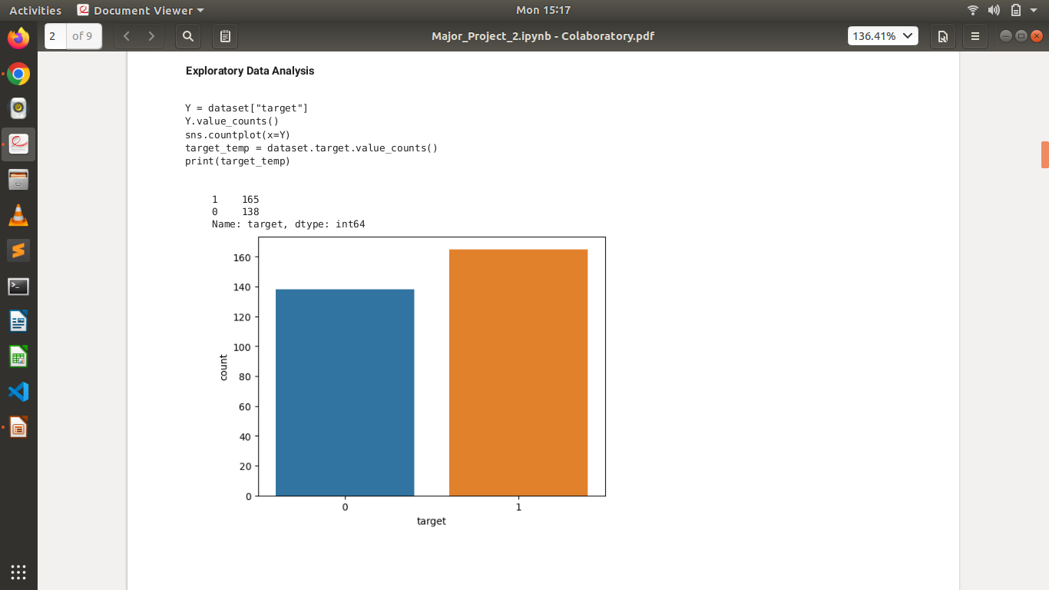

Slide 17
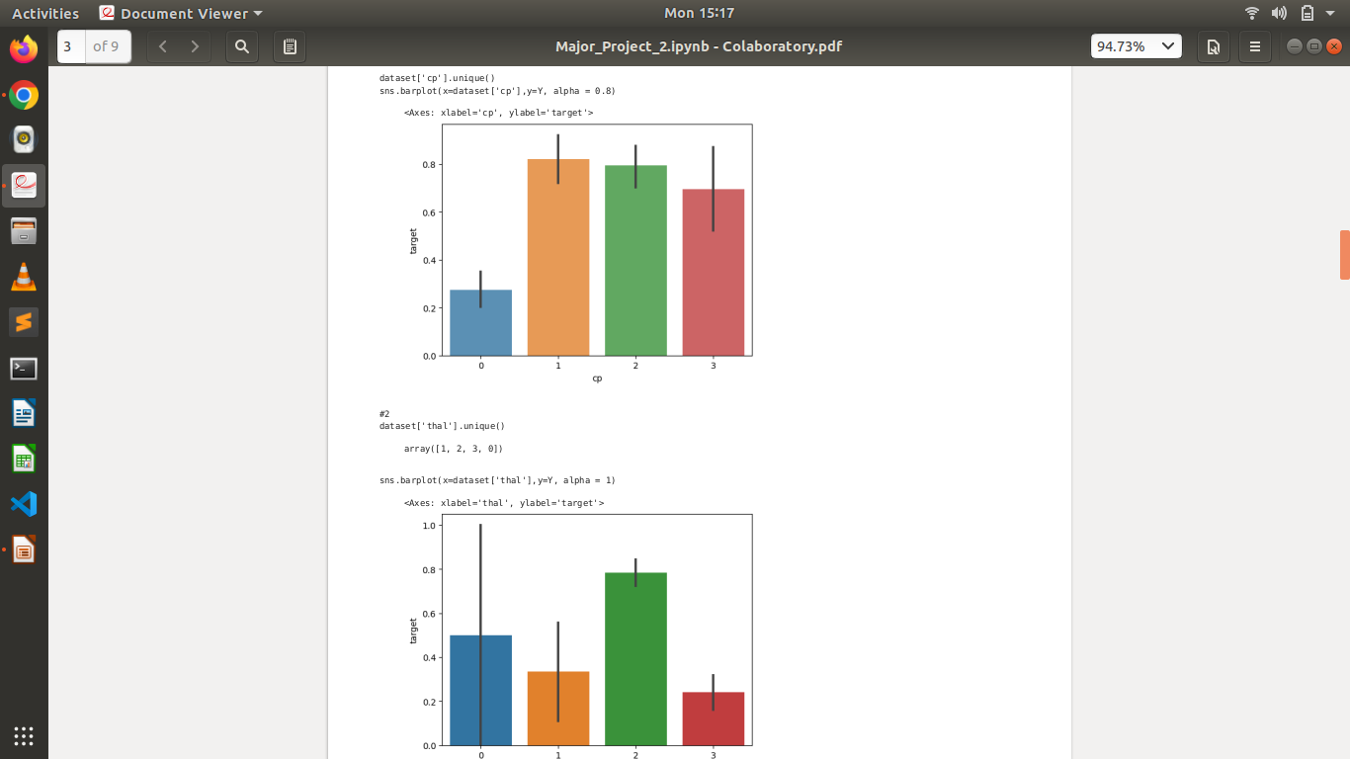

Slide 18
Model Building & Evaluation
The Model building is performed after Exploratory data analysis of the dataset and various machine learning models are deployed.
Various models are used to fit the data and aims to find the best algorithm that fits the data well and gives the best accuracy for prediction.
The scikit - learn is the significant Python library used to import and create the machine learning models
The model is evaluated by using “accuracy_score” function to get the accuracy percentage of the model.

Slide 19
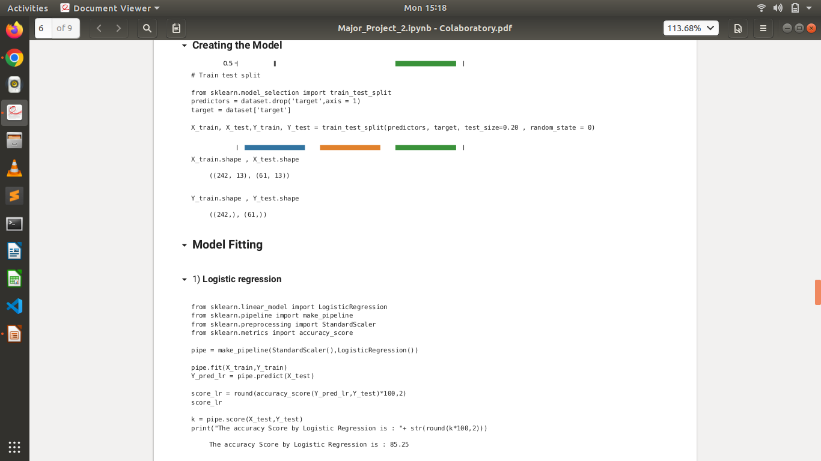

Slide 20
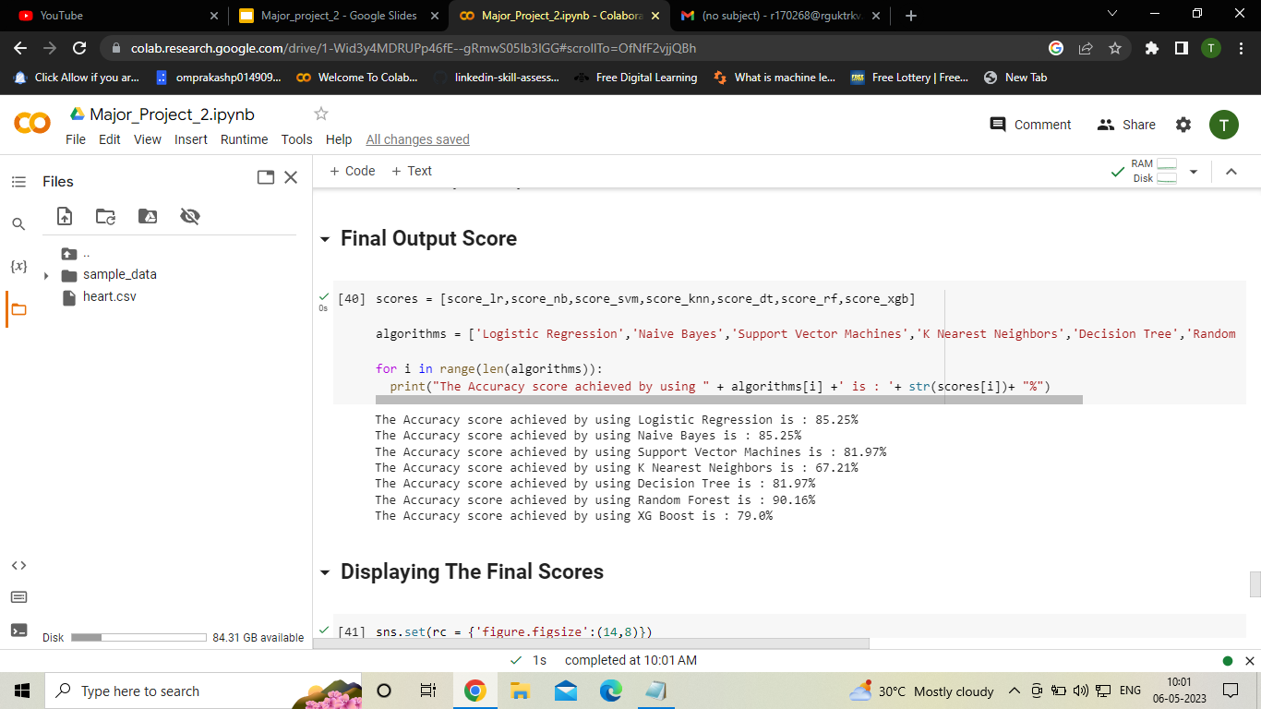
Final Output of the Models

Slide 21
Comparison of Models
S.No | Model Name | Accuracy Score (in %)
1. | Logistic Regression | 85.25%
2. | Naive Bayes | 85.25%
3. | Support Vector Machines(SVM) | 81.97%
4. | Decision Tree | 81.97%
5. | K - Nearest Neighbors | 67.21%
6. | Random Forest | 90.16%
7. | XG Boost | 79.0%

Slide 22
Model Comparision
Various Machine learning algorithms are imported and deployed for the prediction and respective accuracy scores of each algorithm are obtained by the accuracy_score method in terms of percentage.
Now , the various algorithms accuracy percentages are compared with each other.We figure out the best performing algorithm based on the highest accuracy scores for the purpose of best prediction accuracy.
We visualised the the barplot of the model accuracies by seaborn library as follows.

Slide 23
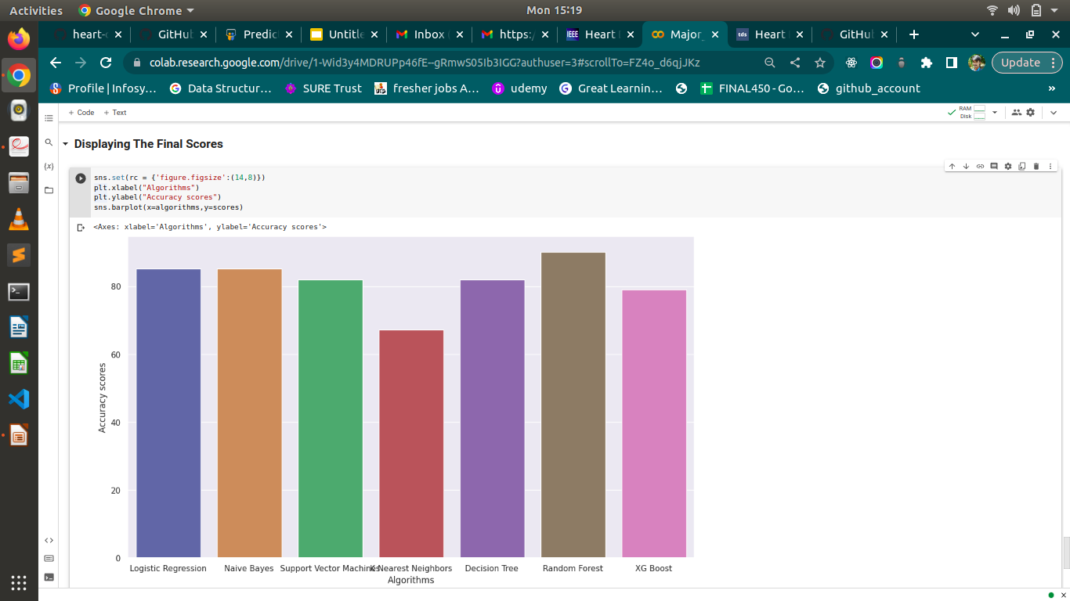

Slide 24
Future Enhancement
In future we can produce an impact in the accuracy of the decision tree and vector machines for additional Improvement after applying advance techniques.
The automation of heart stroke prediction using actual real time data from health care organizations and agencies which can be built using big data.
By using the data , investigation and more accurate prediction can be obtained using real time data.

Slide 25
Conclusion
Heart Stroke Prediction is very challenging and very important in medical field to ensure health information of a person.
We proposed the Random forest model with high accuracy in prediction about 90.16% ensures accurate prediction and performance on predicting the risk of heart stroke in a person based on his health stats.
This helps most of the people to be aware and can prevent heart stroke by following necessary steps as preventive measures.

Slide 26
Thank You

